Slide 1
A8024 Product Realization
VARDHAMAN COLLEGE OF ENGINEERING, HYDERABAD
Autonomous institute, affiliated to JNTUH
Product Realization Review
Team No. - 11
Prevention of Fire in Electric Vehicles
By
22881A12H0 – P.Vineesh Goud
22881A12H2 – P.Deepak Teja
22881A12H3 – P.Varsha Sree
22881A12H4 – R.Ajay Kumar
22881A12H5 – R. Jyothirmai
22881A12J5 – U.Shyam Sundhar
Under the guidance of
Ms. A.Rajitha
Assistant Professor

Slide 2
A8024 - Product Realization
OUTLINE
Introduction (Bullets with Images/Background knowledge)
Problem statement
Applications
Conceptualization (Concept Design of Product with pin to pin connections)
Proposed Solutions
Working of the Product
Product Picture
Conclusion
References

Slide 3
A8024- Product Realization
INTRODUCTION
The rapid evolution of electric vehicles (EVs) has sparked a paradigm shift in the automotive industry, offering cleaner and more sustainable transportation solutions. However, with innovation comes the imperative to address new challenges, one of which is the prevention of fires in electric vehicles. As the demand for EVs continues to surge, understanding and mitigating the risks associated with their unique power systems is paramount to ensuring both user safety and the continued success of electric mobility.

Slide 4
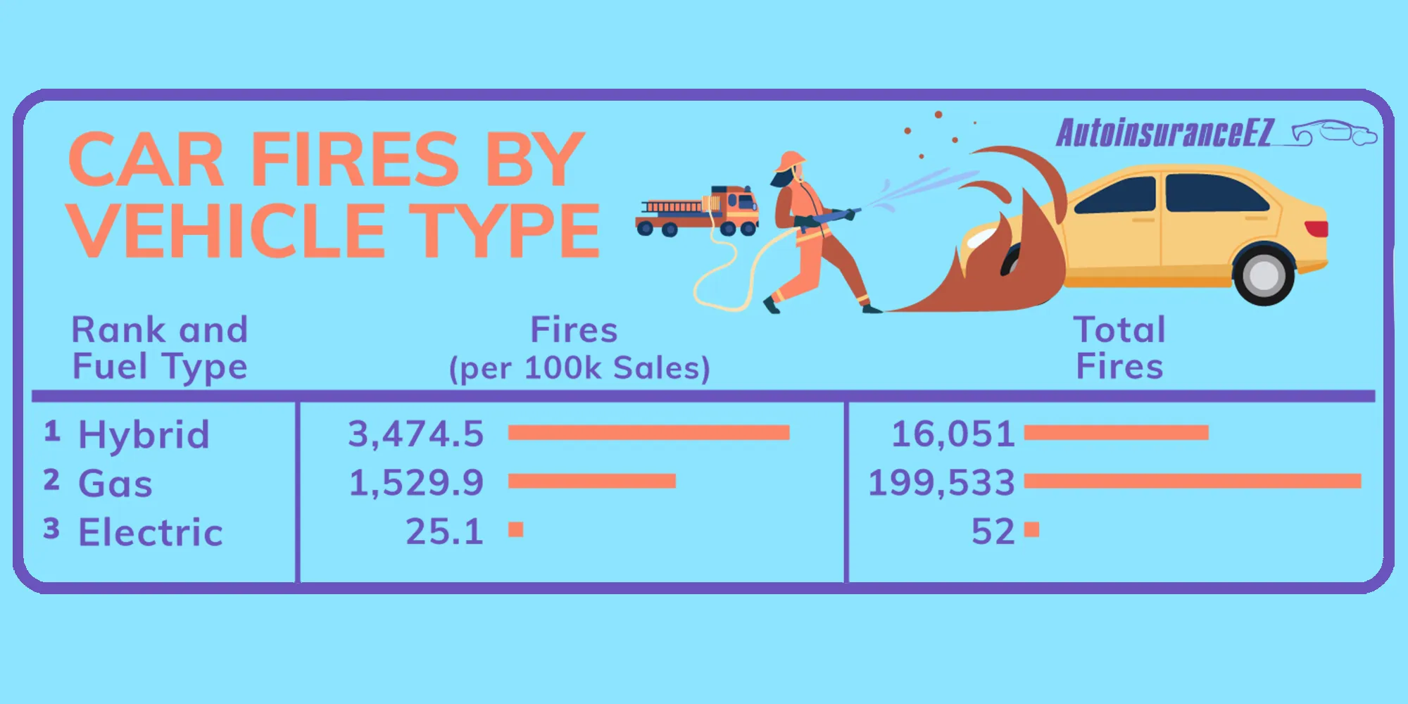
A8024 - Product Realization
PROBLEM STATEMENT
The problem statement focuses on identifying and addressing the key factors contributing to fire incidents in electric vehicles. This includes understanding the underlying causes such as thermal runaway, electrical faults, external impacts, and charging infrastructure vulnerabilities. Additionally, the lack of standardized safety protocols and guidelines specific to EVs exacerbates the challenge of mitigating fire risks effectively.

Slide 5

A8024 – Product Realisation
APPLICATIONS
*Economic Growth
.
*Cost Savings
*Reduced Pollution

Slide 6
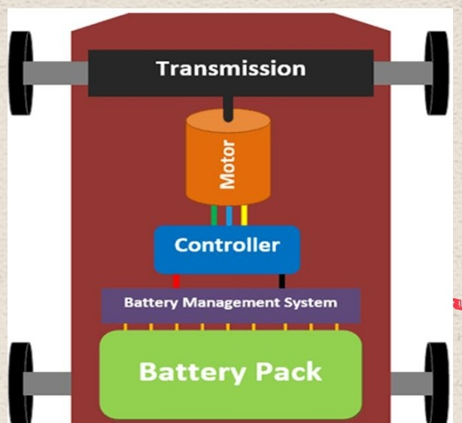
A8024 - Product Realisation
BLOCK DIAGRAM

Slide 7
A8024 - Product Realization
PROPOSED SOLUTIONS
• Thermal management in electric vehicles.
•Battery thermal management.
•Cooling loop in electric vehicles.
•The project is to monitor the battery temperature and smoke detection to alert the electric vehicle user’s via smart phone notification, alarm and also to cut off the electric vehicle to avoid further damages.

Slide 8
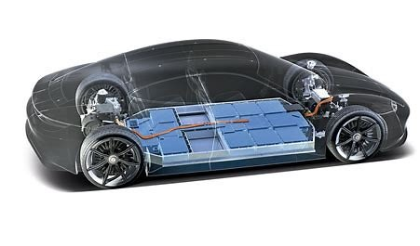
A8024 - Product Realization
WORKING OF PRODUCT
•Usually,the cooling system regulates the vehicle temperature.
•In cooling loop, acoolant is circulated using an electric pump to cool the batteries.
•The air conditioning system used in electric vehicles to cool down the systems within the cooling loop.

Slide 9
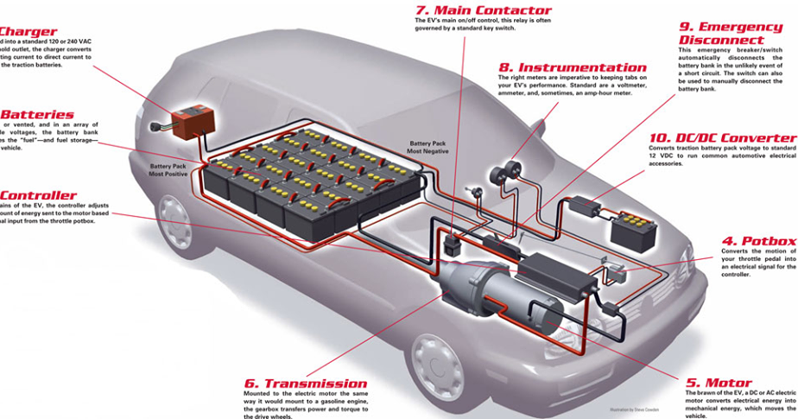
A8024 - Product Realization
PRODUCT PICTURE

Slide 10
A8024 - Product Realization
CONCLUSION
In conclusion, proactive fire prevention measures are essential to realizing the full potential of electric vehicles as a sustainable transportation solution. By addressing the unique challenges posed by EVs and implementing robust safety protocols, we can accelerate the transition to a cleaner, greener future while prioritizing the well-being of drivers, passengers, and communities worldwide.

Slide 11
A8024 - Product Realization
REFERENCES
[1] Wang Q, Ping P, Zhao X, Chu G, Sun J, Chen C. Thermal runaway caused fire and explosion of lithium-ion battery. Journal of Power Sources 2012; 208:210–24.doi: 10.1016/j.jpowsour.2012.02.038.
[2] Wang Q, Mao B, Stoliarov SI, Sun J. A review of lithium-ion battery failure mechanisms and fire prevention strategies. Progress in Energy and Combustion Science 2019; 73:95–131.doi: 10.1016/j.pecs.2019.03.002.
[3] Feng X, Ouyang M, Liu X, Lu L, Xia Y, He X. Thermal runaway mechanism of lithium-ion battery for electric vehicles: A review. Energy Storage Materials 2018; 10:246–67. doi:10. 1016/j.ensm.2017.05.013.
.

Slide 12
A8024 - Product Realization
[4] Ouyang D, Chen M, Huang Q, Weng J, Wang Z, Wang J. A Review on the thermal hazards of the lithium-ion battery and the corresponding countermeasures. Applied Sciences 2019; 9:2483. doi:10.3390/app9122483.
[5] Evarts EC. Lithium batteries: To the limits of lithium. Nature 2015; 526: S93–5. doi:10.1038/526S93a.
[6] Garcia-Valle R, Lopes JAP. Electric vehicle integration into modern power networks. Springer-Verlag New York; 2013. doi:10.1007/978-1-4614-0134-6
[7] Dinger, Andreas; Martin, Ripley; Mosquet, Xavier; Rabl, Maximilian; Rizoulis, Dimitrios; Russo, Massimo S. Batteries for Electric Cars: Challenges, Opportunities, and the Outlook to 2020. The Boston Consulting Group 2010.

Slide 13
A8024 - Product Realization
[8]Jagdish, M., Singh, R., & Sharma, D. K. (2018). Design and development of low-cost automatic irrigation system using soil moisture sensor and rain sensor. International Journal of Current Engineering and Technology, 8(5), 1183-1187.(https://www.irjet.net/archives/V5/i3/IRJET-V5I3412.pdf)
[9]Ozdogan, M., & Sammis, T. W. (2001). A remote sensing and GIS-based model to assess regional evapotranspiration in the Upper Missouri River Basin. Journal of Hydrology, 251(1-4), 219-229.
[10] Obaideen, K., Yousef, B.A., AlMallahi, M.N., Tan, Y.C., Mahmoud, M., Jaber, H. and Ramadan, M., 2022. An overview of smart irrigation systems using IoT. Energy Nexus, 7, p.100124.

Slide 14


A8024 - Product Realization
Thank You !!!

Slide 15
A8024 - Product Realization
Any Questions/Discussions ???

